Slide 1

Guardian View Real-Time Weapon Detection System
Enhancing Security Through AI-Powered Video Analysis
Authors: Dori Rozen and Omer Iny
Advisor: Mr. Rozewaks Yoram

Slide 2
Welcome to Our Final Project Presentation
We've developed a weapon detection system that utilizes real-time video streaming and advanced AI techniques to enhance security in various environments.
Our system addresses the critical need for rapid threat detection in public spaces, potentially saving lives by providing early warnings to security personnel. By leveraging YOLO AI technology, we've created a robust, scalable solution that can be deployed in diverse settings such as streets, schools, airports, and public events.

Slide 3
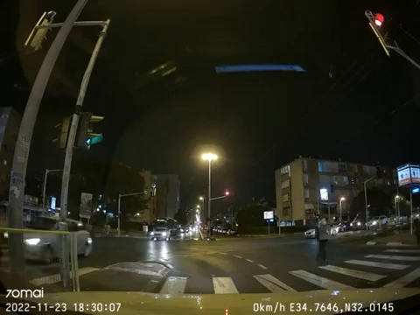
Why we chose This Project?

Slide 4
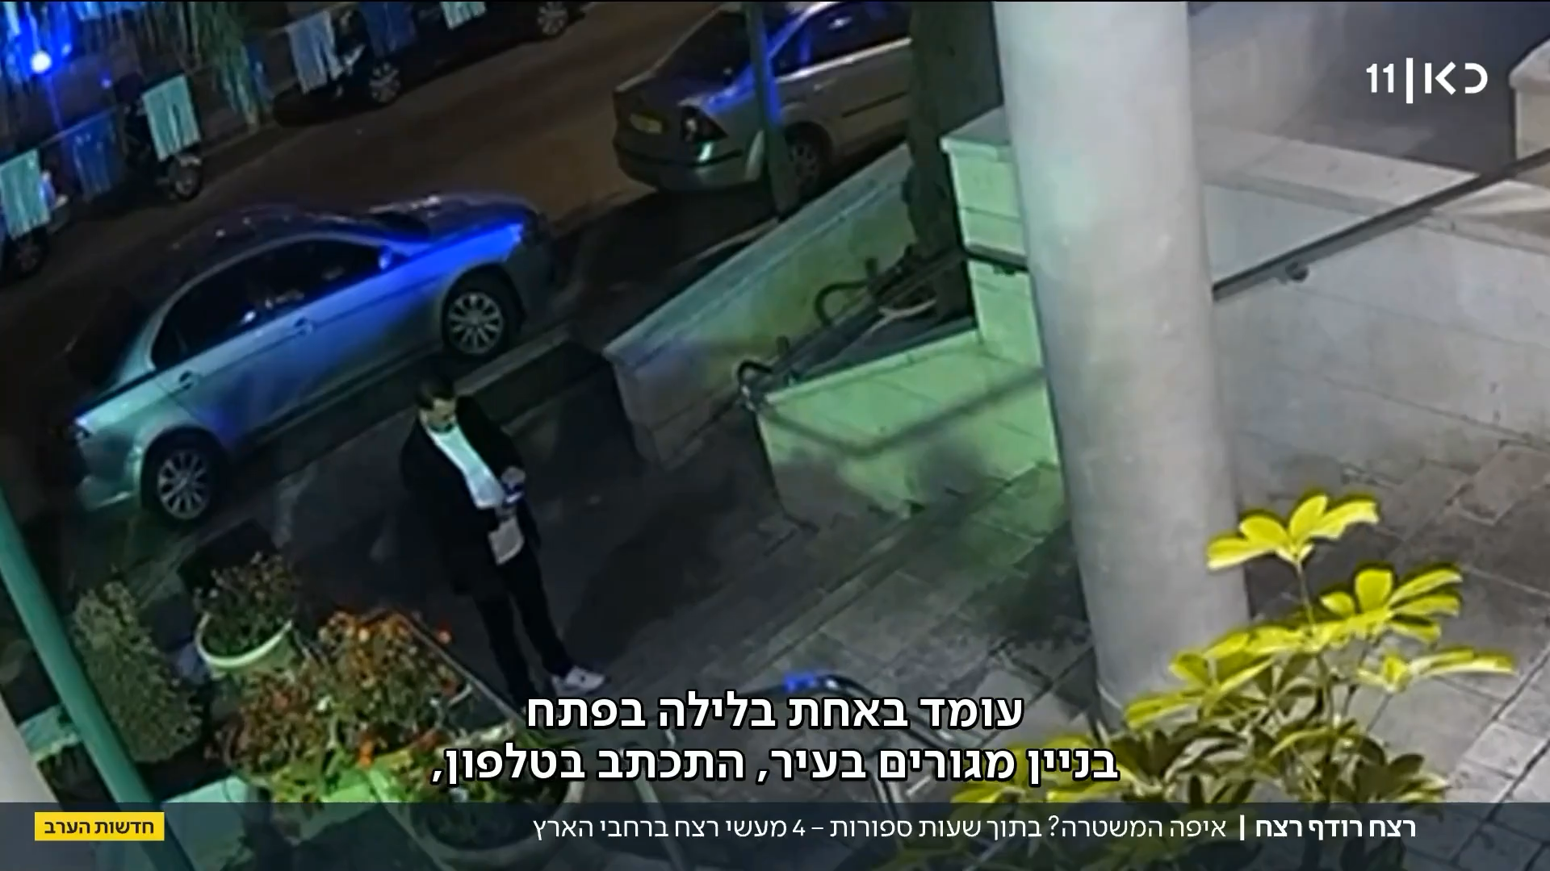

Slide 5
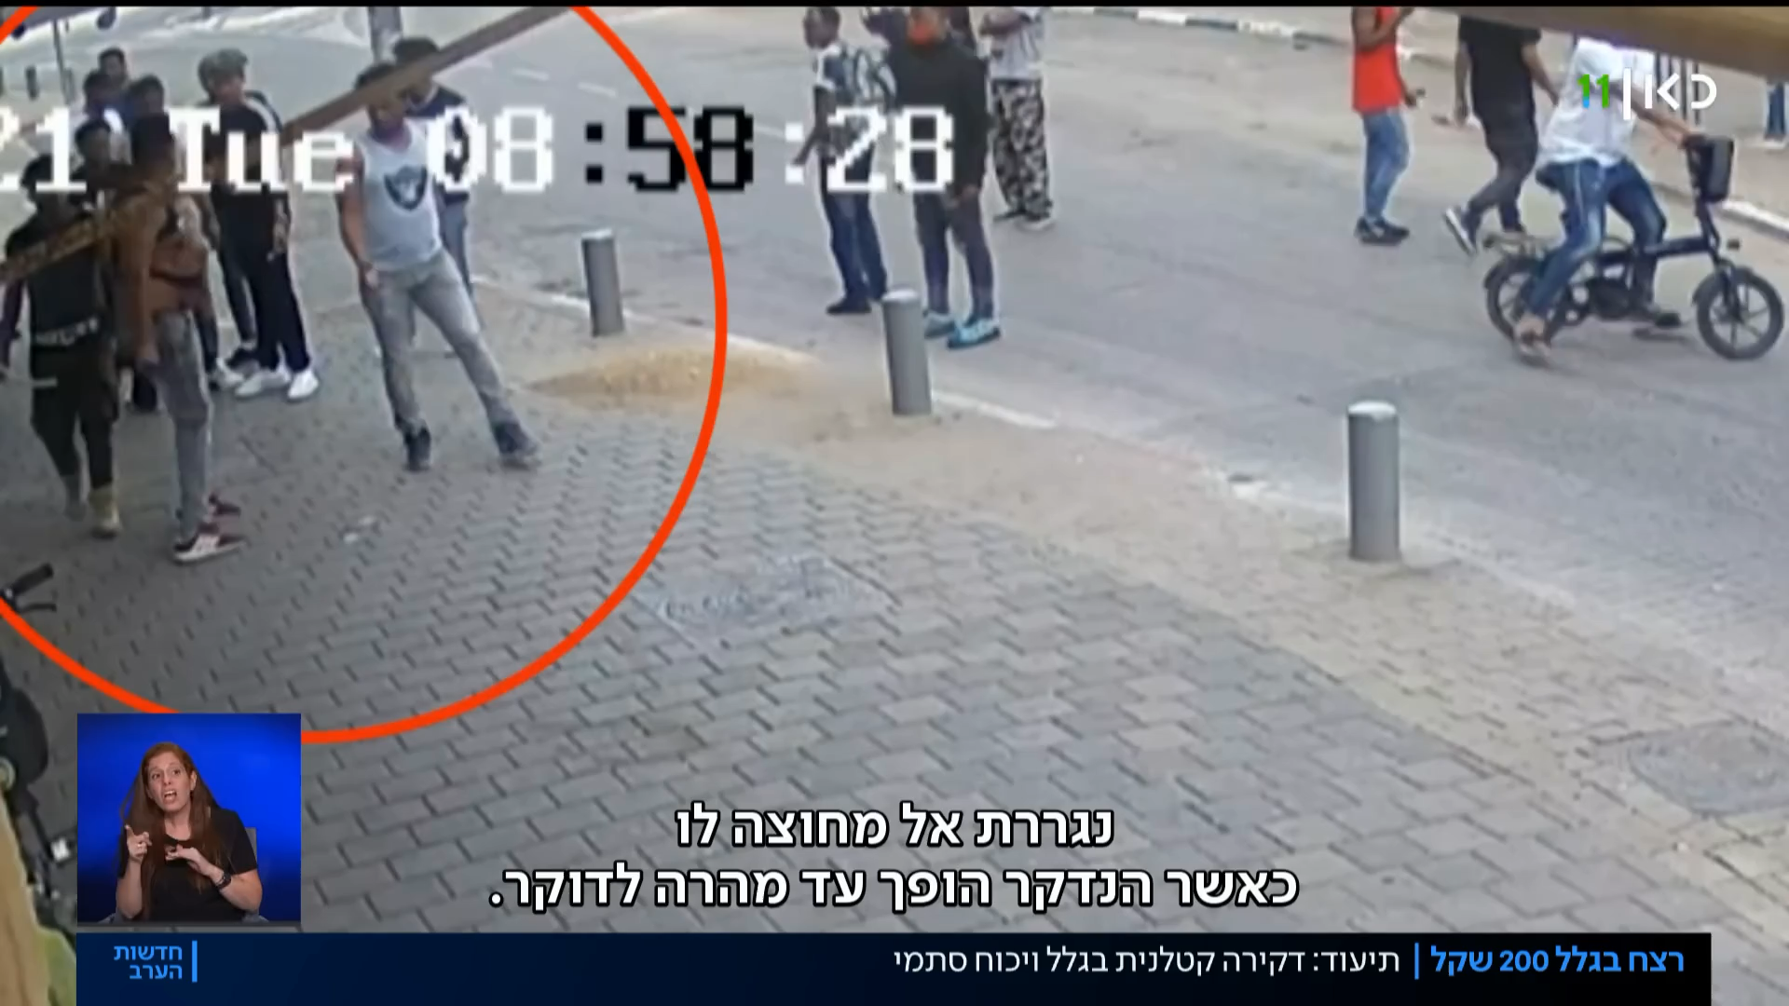

Slide 6
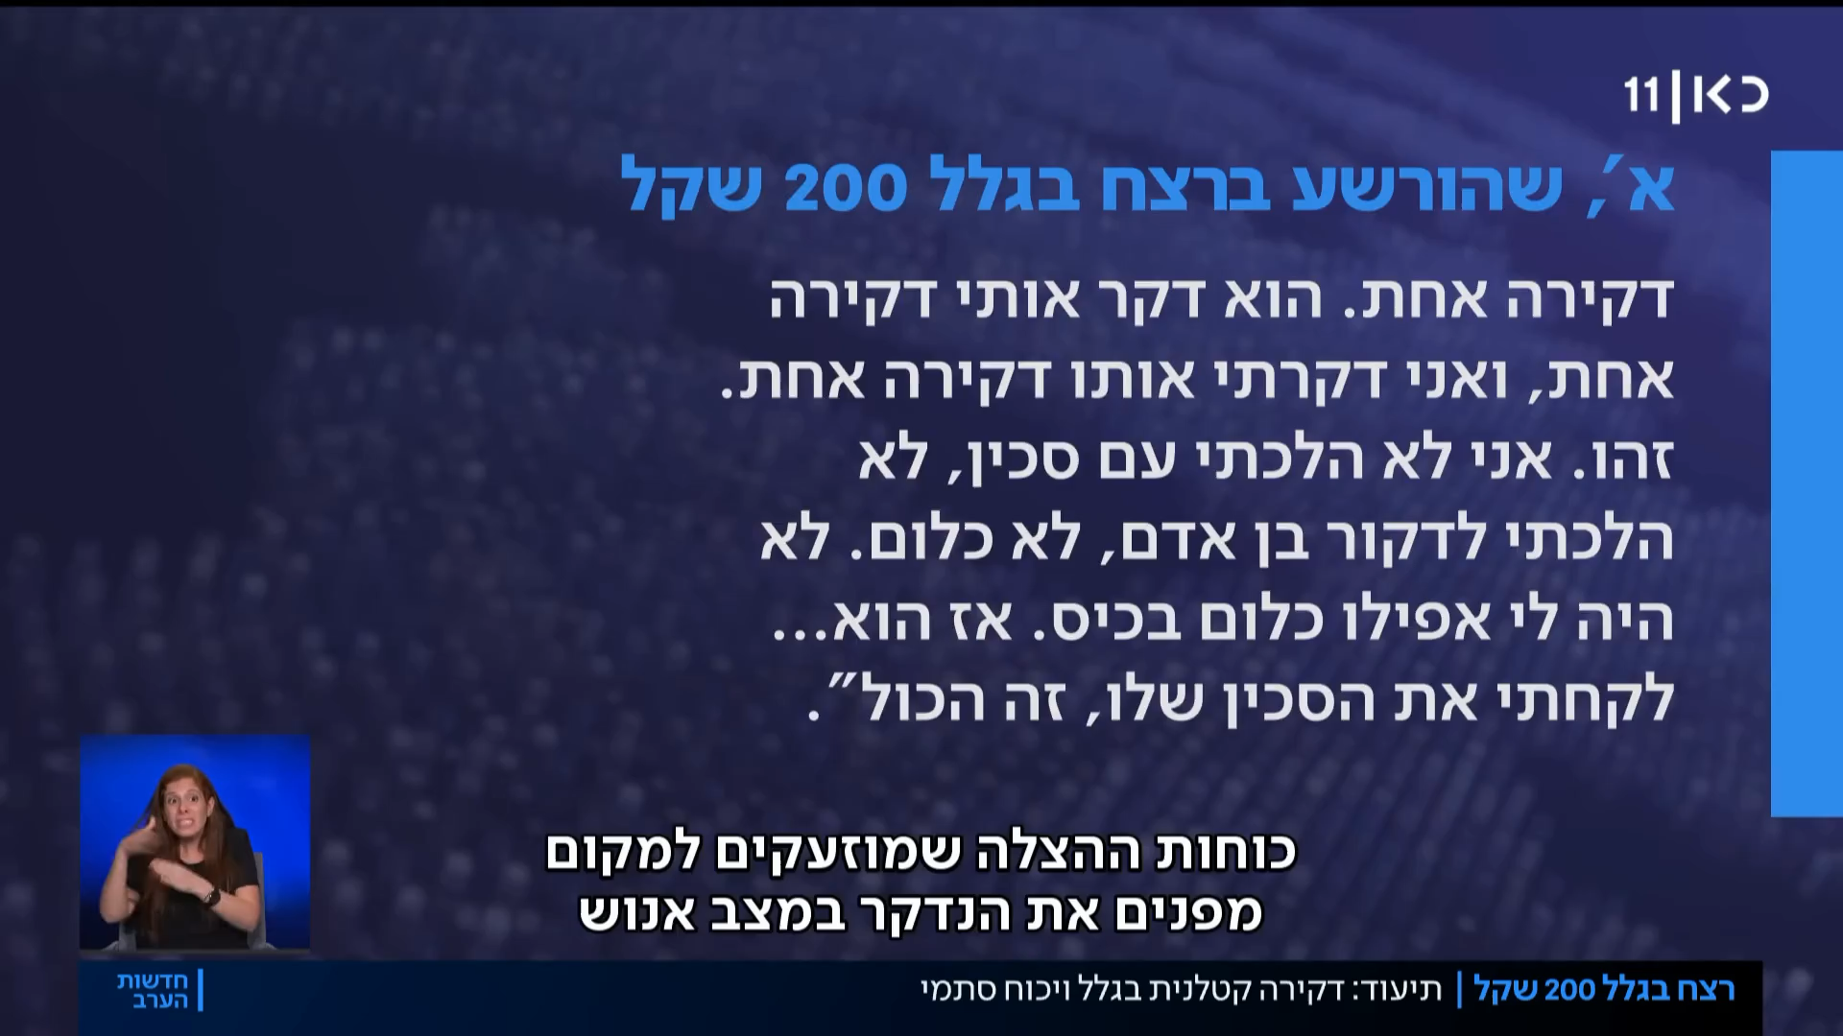

Slide 7

Project aim and significance.
Providing instant, detailed alerts to relevant authorities, eliminating delays in threat reporting, delivering precise information about the incident's location and reduce reaction time..
Significantly reduce response times to potential security threats recognizing that every second saved can be crucial

Slide 8
Project Overview
Our weapon detection system is designed to address the growing concern of public safety in an increasingly unpredictable world. By harnessing the power of artificial intelligence and real-time video analysis, we've created a tool that can significantly reduce response times in potential threat situations.
Core Components:
1. YOLO (You Only Look Once) Model
2. Firebase as a mediator for the front and backend
3. Python based backend
4. Flutter Mobile Application

Slide 9
YOLO Model: The Core of Our Detection System
At the heart of our weapon detection system lies the YOLO (You Only Look Once) model, a state-of-the-art object detection algorithm known for its speed and accuracy. We chose YOLOv8 for its ability to process images in real-time, making it ideal for our video stream analysis and the best algorithm currently on the market for real time object detection.
Performance metrics:
Precision : 0.881 accuracy of positive predictions over total positives
Recall : 0.887 Correct detections over actual positives.
mAP50 : 0.908 Mean Average Precision with at least 50%

Slide 10
Firebase Integration
Firebase serves as our mediator between the frontend and backend as well as providing:
Real-time database
User authentication
Cloud storage for video streams

Slide 11
Flutter Application
Our mobile application is built with Flutter, offering:
Cross-platform compatibility (iOS and Android)
Real-time alert system
User-friendly interface for security personnel
Integration with Firebase for seamless and fast data flow

Slide 12
System Workflow
Key Features:
User management
YOLO process Video and live video analysis
Alert generation with the model detections visualized.
Navigating to the scene
Workflow Steps:
1. Video streams are captured from user videos or live webcam
2. Frames are processed with our YOLO model
3. Detected weapons trigger alerts in the Firebase backend according to the set threshold
4. Flutter app receives an update for a new alert and displaying it to user 5. Security personnel can view threat details and respond accordingly

Slide 13
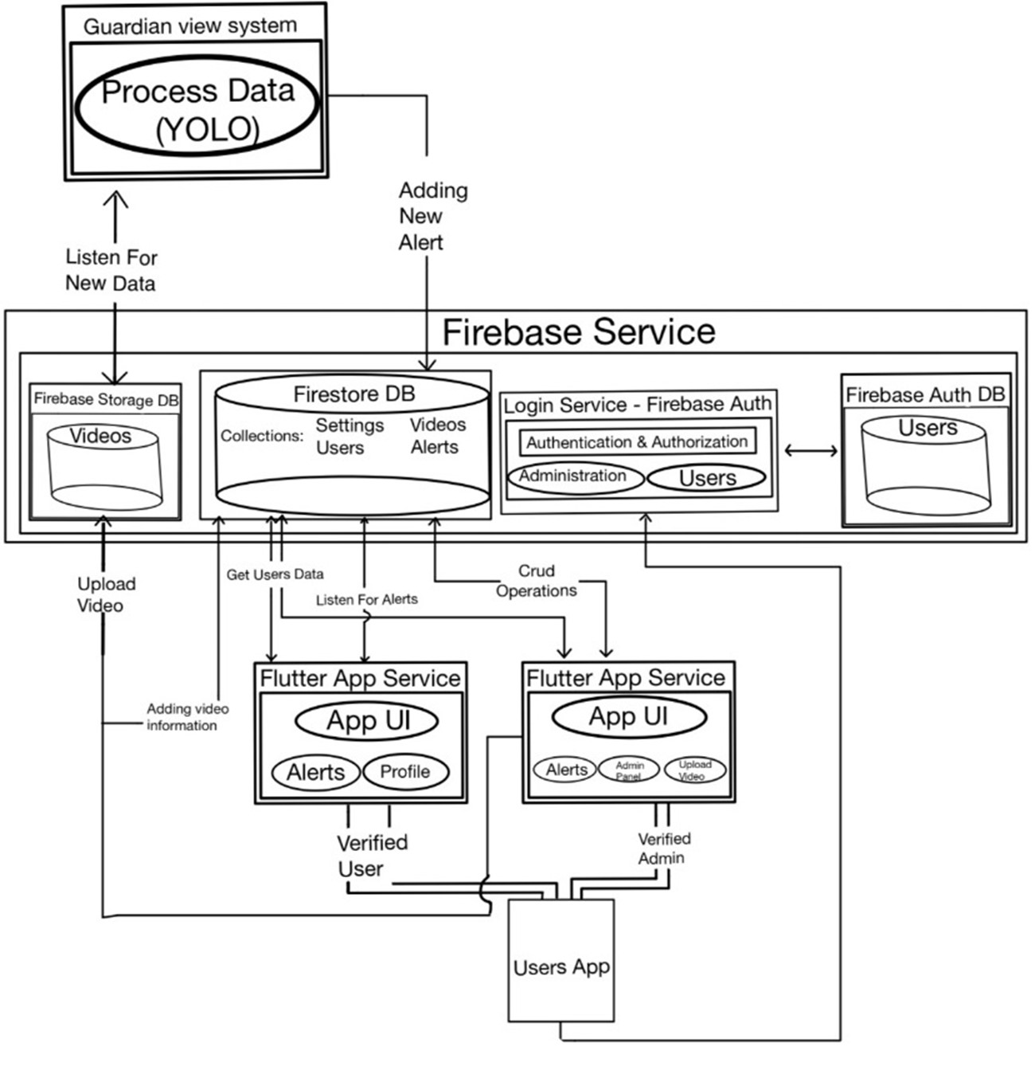
System Architecture
Key Components:
AI Model: Custom-trained YOLOv8 for weapon detection
Backend: Python system for video processing
Frontend: Flutter mobile app
Database: Firebase Firestore
Storage: Firebase Storage
Authentication: Firebase Auth

Slide 14
Development Challenges
Challenges Faced:
Lack of live camera feeds
Lack of data and computing power to train the model
Learning a couple of new technologies that wasn’t learned in Afeka such as Ultralytics, Flutter and Firebase
Solutions:
Training with limited data and going with Andrey karpathy theory
Simulating feeds by videos selected for testing

Slide 15
Let's Watch Our System in Action

Slide 16

Future Enhancements
Potential improvements and features for future development:
Integration with live security camera feeds for real-time monitoring and usage
Training the model with more computing power and with more data from CCTV footage
Additional features such as tracking suspects, alert people in the close environment for possible dangers and increase awareness.

Slide 17
Thank You!

